Slide 1

AIML Group Lab Team 14
Early Disease Detection for Farm Activities
to
Improve Agriculture Productivity

Slide 2
Agenda
Problem Statement
Introduction to Team
Response to the Questionnaire (Refer Abstract)
Business Applications, Post course
Q & A

Slide 3
Problem Statement
G14 Farmer is in the domain ( Vegetables/FruitAndNut/Row crop), wants to identify diseases faster and efficiently for effective crop realization.
Given the huge set of variables(disease types) with subjective data, Farmer is manually identifying diseases (features).
Identifying diseases consumes time of Farmer, prone to human error.
Reduced manual intervention for cost reduction.

Slide 4
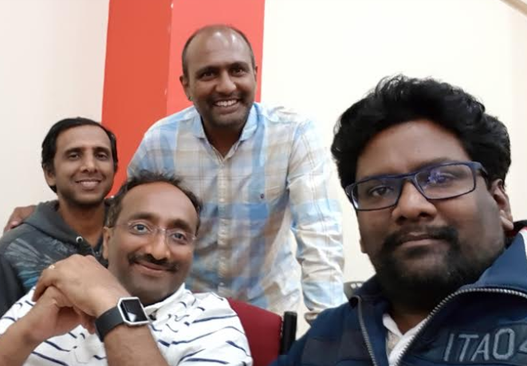
Team
Srikanth - HP
Kiran - Ciber
Chandra - SAP
Magesh - Wipro
Krishnam - Cogniverse

Slide 5
Solution Proposed ( Approach )
CNN with LSTM
Captures data ( Field Data )
Capture disease data set ( herniside dataset )
Tomato and Vegetable ( Tomato, Cabbage )
Fruit and Nut ( Apple , Grape , Strawberry )
Row Crop ( Rice, Wheat, Soy Bean) )
Analyses the data captured
Identify Issues
Makes the recommendations

Slide 6
Answers to the Questionnaire (Data)
We chose this dataset because a) Domain expertise ( Herbicide Injury Image Dataset ) b) Interest in the area ( Supply Demand shortages due to failed crops ) c) Growth potential ( This solution can be extended to other Farming domains like Aqua Culture, Cattle Farms )

Slide 7
Answers to the Questionnaire (Pre-processing)
Pre-Processing Image Dataset related to the domain of vegetables/fruits and nuts
Image Data set and Actual Image feature engineering
Image Data set and Actual Image ( images ) features need to be reduced

Slide 8
Answers to the Questionnaire (Algorithms)
CNN ( Convolution Neural Network )
LSTM ( Long Short Term Memory Networks )
Notes:
CNN – Extracting the features of interest
LSTM – Match the diseases with Imagenet dataset domain data, predict the disease

Slide 9
Answers to the Questionnaire (Expected End Results)
Identify Disease in Early Phase

Slide 10
Post Course
Build a rapid prottype to evalute the propose solution

Slide 11
Q & A

Slide 12
Thank you!

